Slide 2
Elevating the Role of the Anaesthetist in
NMB Management
Jan Paul Mulier, MD, PhD

Slide 3
Anaesthetist
Like an engineer in a great steamship,… Fundamental knowledge of physiologic phenomena… No routinist,
no tyro, no cocksure,…
  Saxton Pope. The relation of the surgeon to the anesthesiologist. Cal State J Med. 1922; 20: 385
OR-manager improving overall quality and efficiency of economic resources
  Gebhard E. OR-manager: surgeon or anesthesiologist? An interdisciplinary study Anaesthesist. 2003; 52:1062
Managing high-performing and high-reliability teams to achieve high-quality surgical care
  Leach LS. Assessing the performance of surgical teams. Health Care Manage Rev. 2009; 34:29.

Slide 4
Anaesthetists in the Operating Room Face Problems in the Way Others See Us
Recognition by the patients: Anaesthetists often remain in anonymity.
    Wetchler BV. Patients don‘t know who we are. ASA Newsletter 1994; 58:2–4.
    Kindler CH The patients' perception of the anaesthetist. Anaesthesist 2002; 51:890
Recognition by the surgeon: Anaesthetists are often seen as coffee drinkers, barring surgical work for ‘safety’
  Gfrörer R. Role expectations of various professional groups in the operating theatre. Anaesthesist. 2007; 56:1163.
  Coe R J Disagreement and aggression in the operating theatre. Adv Nurs. 2008; 61:609. “Aggressive behaviour from surgeons”

Slide 5
From Safety to Improving Surgery
Safety in anaesthesia has increased a lot!
  While surgical safety is still 10 times less!
  PONV, post-operative pain, and discomfort are important to the patient but are these recognised by the surgeon?
Danger of losing attention, scientific interest.
Solution:
  Make anaesthesia more meaningful for surgeons.
  Try, as an anaesthetist, to be involved in improving surgical patient outcome.

Slide 6
The Evolving Role of the Anaesthetist
Being a team is not enough
  Everyone plays only his role
Being a transdisciplinary team is the future
  Improve the surgical work using your skills, knowledge and approach as an anaesthetist.
    In bariatric surgery anaesthesia reduced post operative bleeding,
    post operative leaks
NMB have been used to improve anaesthesia induction, intubation, and to facilitate ventilation…
Today, NMB should be used to improve surgery
  Better working conditions
  Potential for faster work/improved efficiency
  Opportunity to reduce complications/improve outcomes

Slide 7
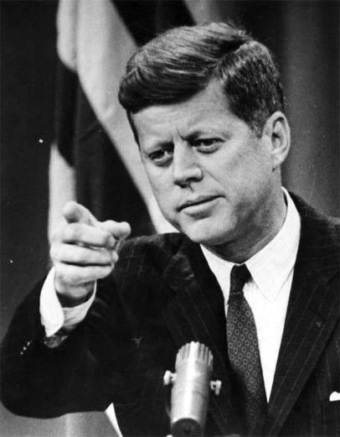
J F Kennedy
Inventor of the “transdisciplinarity”
  Ask not only “what the country can do for you” ask also “what you can do for your country.”
Same question to the surgeons
  ‘Ask not only what the anaesthetist can do for you, ask also what you can do for the anaesthetist.’

Slide 8
Practical Team Work
Video with NMB abdominal compliance measuring

Slide 9

Break
Please proceed to your next workshop assignment for Session 2 promptly at 18:00.

Slide 10


Please proceed to the Barcelona Ballroom for the remainder of today’s sessions.

